Slide 1

Water Potability Detection
Submitted By:- Submitted To:
Hitansh Mangla - F – 2115000473 Dr.Sanjay Madan
Ayush - M – 2115000248 Technical Trainer
Nikunj - K – 2115000672 Dept. of T&D
Achintya Gupta- J-2115000043

Slide 2

Contents
Introduction
Literature Review
Dataset
Analysis of Algorithm
Project Pipeline
Result and discussion
Conclusion

Slide 3
Introduction
Water Potability Detection using Machine learning
A Water Potability detection using Machine Learning aims to assess the safety of a specific water source for drinking by employing various ML algorithms to analyze the quality of water.
This project aims to automate the assessment process by developing a model that can predict water potability based on water quality data

Slide 4
Problem Statement
With the population and the ever increasing need for various resources we are faced with a dilemma in how to manage our lives. Sometimes we end up by utilizing a poor or contaminated source of water for our use.
The proposed system aims to provide the solution for the same by allowing users to monitor the water quality from a given sample of water and predict whether water is contaminated or not.

Slide 5
Literature Review

Slide 7
DATASET
• Proposed system is implemented using the water potability dataset from Kaggle . The water_potability.csv file contains water quality metrics for 3276 dataset, 9 features and one class variable.
• Feature lists are pH, Hardness, Solids, Chloramines, Sulfate, Conductivity, Organic Carbon, Trihalomethanes, Turbidity
• Potability is the class label
URL:- https://www.kaggle.com/datasets/adityakadiwal/water-potability

Slide 8
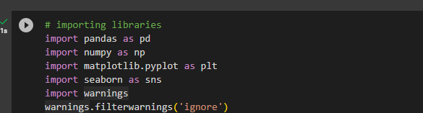
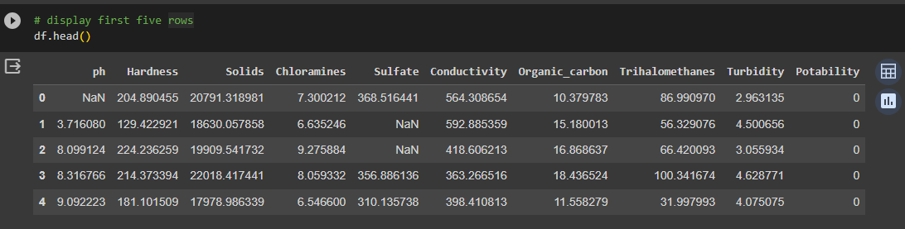
Importing all the libraries
First five rows of the dataset. The dataset contains null values which is rectified further by data preprocessing.

Slide 9
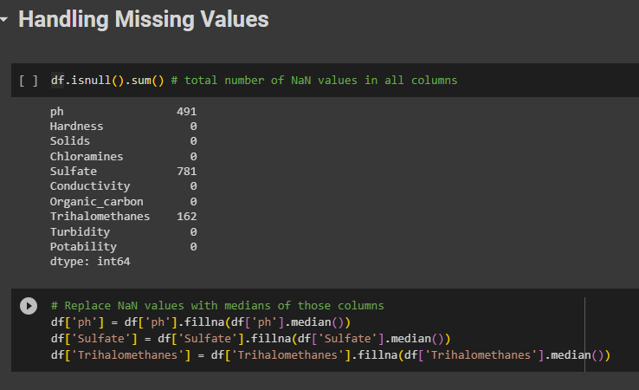
Data Preprocessing
As null values are present in data. Data cleaning is carried out and null values are filled by median of the respective feature.

Slide 10
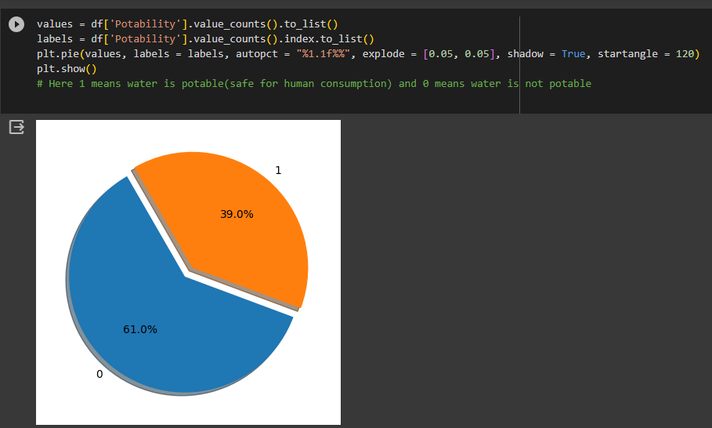
Data Visualization
Here the data visualization of drinking and non-drinking water is done where 1 represents the potable water and zero represents not potable water

Slide 11
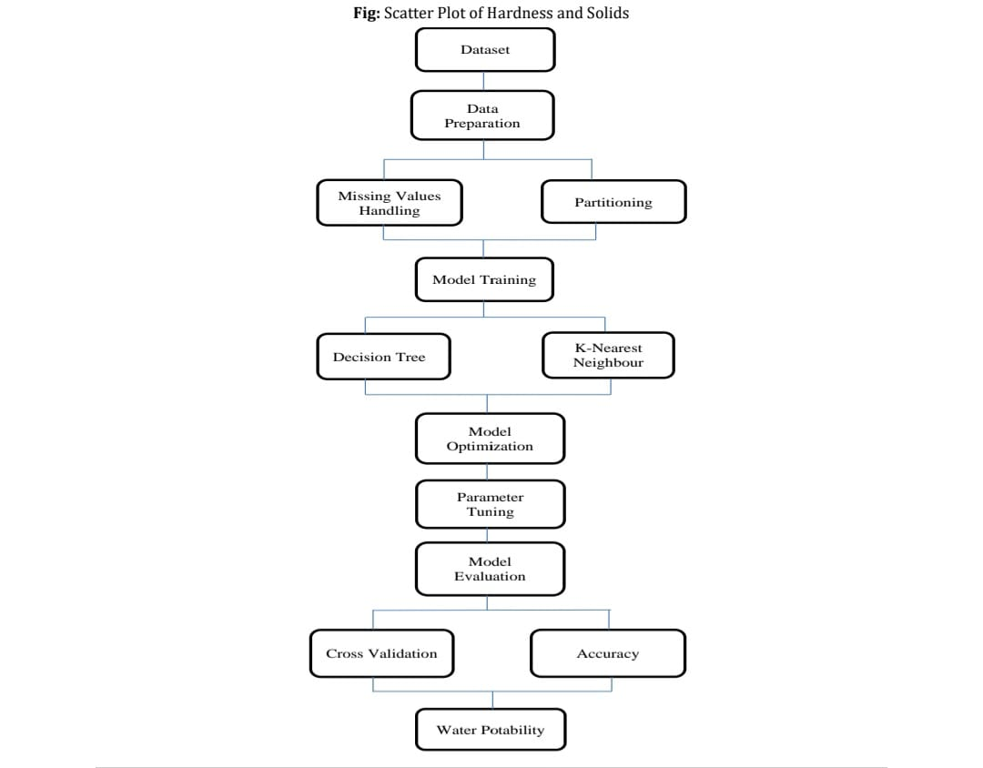
Project Pipeline

Slide 12
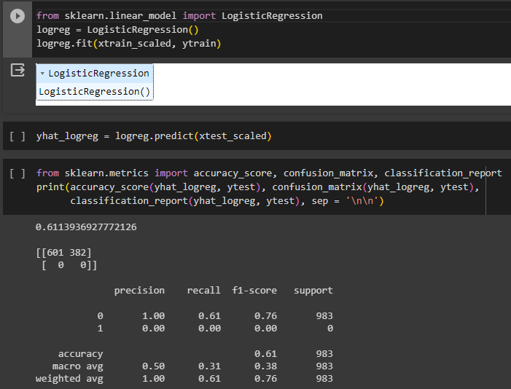
Model Planning
Logistic Regression
Logistic regression is one of the Machine Learning algorithms of Supervised Learning. It is used for predicting the categorical dependent variable using a given set of independent variables. Logistic regression predicts the output of a categorical dependent variable.
Notes:
Logistic regression

Slide 13
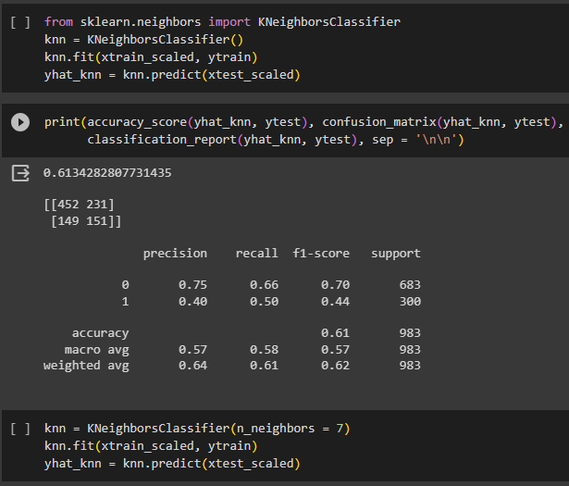
K-Nearest Neighbors(KNN)
KNN stands for
“K-Nearest Neighbor”.
It is a supervised machine learning algorithm.
The algorithm can be used to solve both classification and regression problem statement

Slide 14
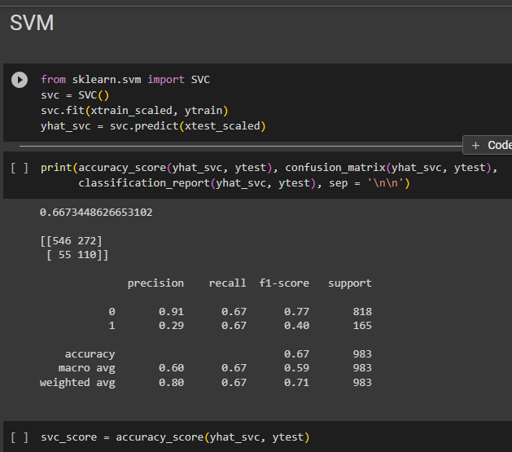
Support Vector Machine
A support vector machine (SVM) is a type of supervised learning algorithm used in machine learning to solve classification and regression tasks .
SVMs are particularly good at solving binary classification problems, which require classifying the elements of a data set into two groups.

Slide 15
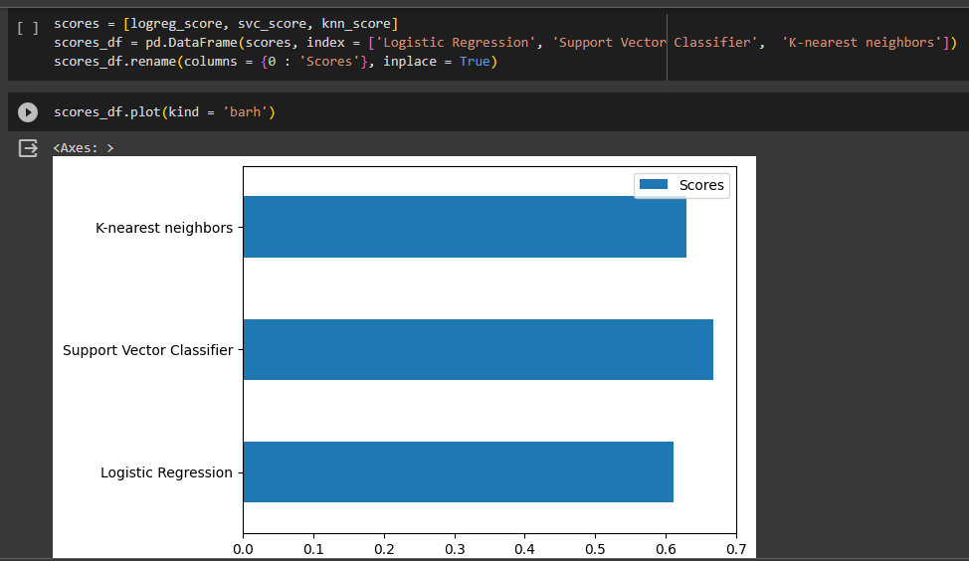
Results
In this we have a bar graph showing comparison between all the model’s accuracy score and we have come to a result that SVM is the best model among all these models.

Slide 16
Conclusion
The project is meant to be replacement to the existing manual system of water testing as the existing system is very time consuming and includes human labor.
The system automates the process of testing the water samples using the various parameters of water. Proposed system takes various parameters of water as the inputs and predicts whether the water sample of the provided parameters are contaminated or not.

Slide 17
Acknowledgement
I would like to express my sincere gratitude to all those who contributed to the successful completion of this mini project. Their support and encouragement were invaluable throughout the entire process .
I extend my heartfelt thanks to Mr. Sanjay Madaan Sir for their guidance, mentorship, and valuable insights. Their expertise and constructive feedback played a crucial role in shaping the project and enhancing its quality .
I am grateful to my teammates for their collaborative spirit and dedication. Each member brought unique skills and perspectives to the project, creating a dynamic and effective team.
I also want to acknowledge the resources and facilities provided by GLA UNIVERSITY MATHURA.
This project would not have been possible without the collective efforts of everyone mentioned above.

Slide 18
THANK
YOU

